Slide 1


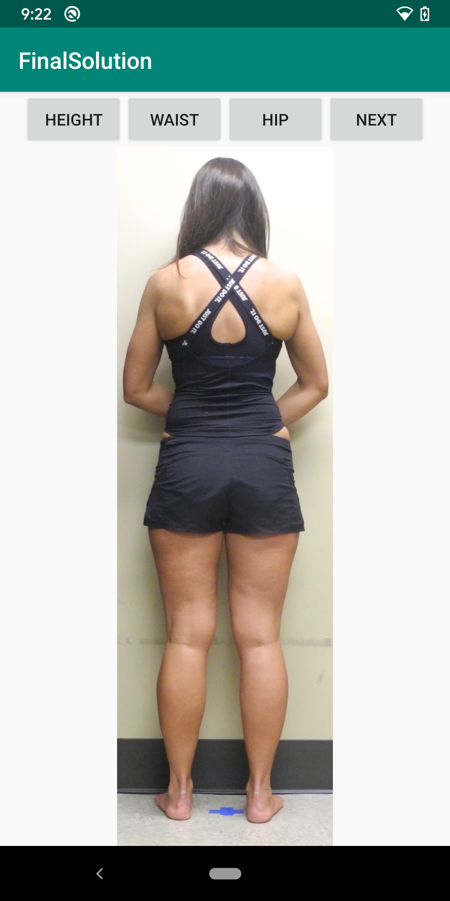
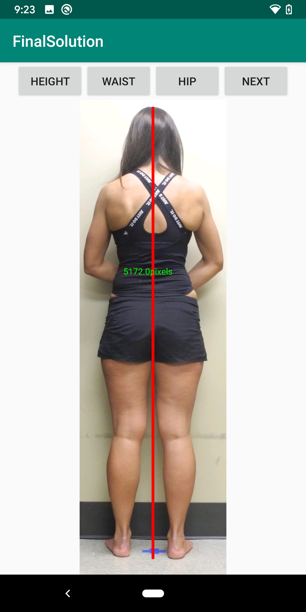

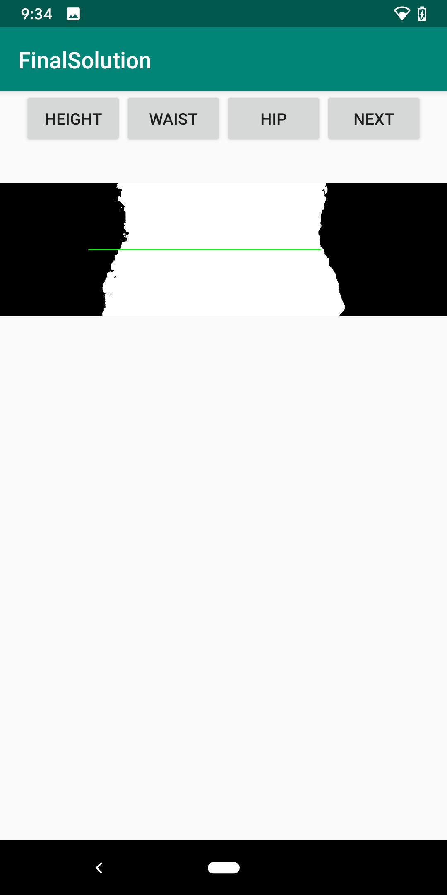
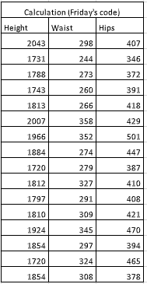
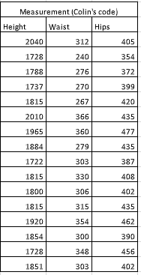
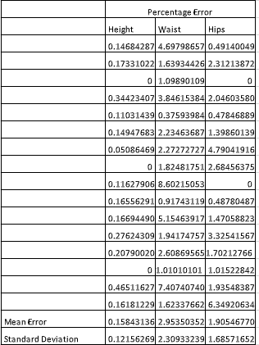
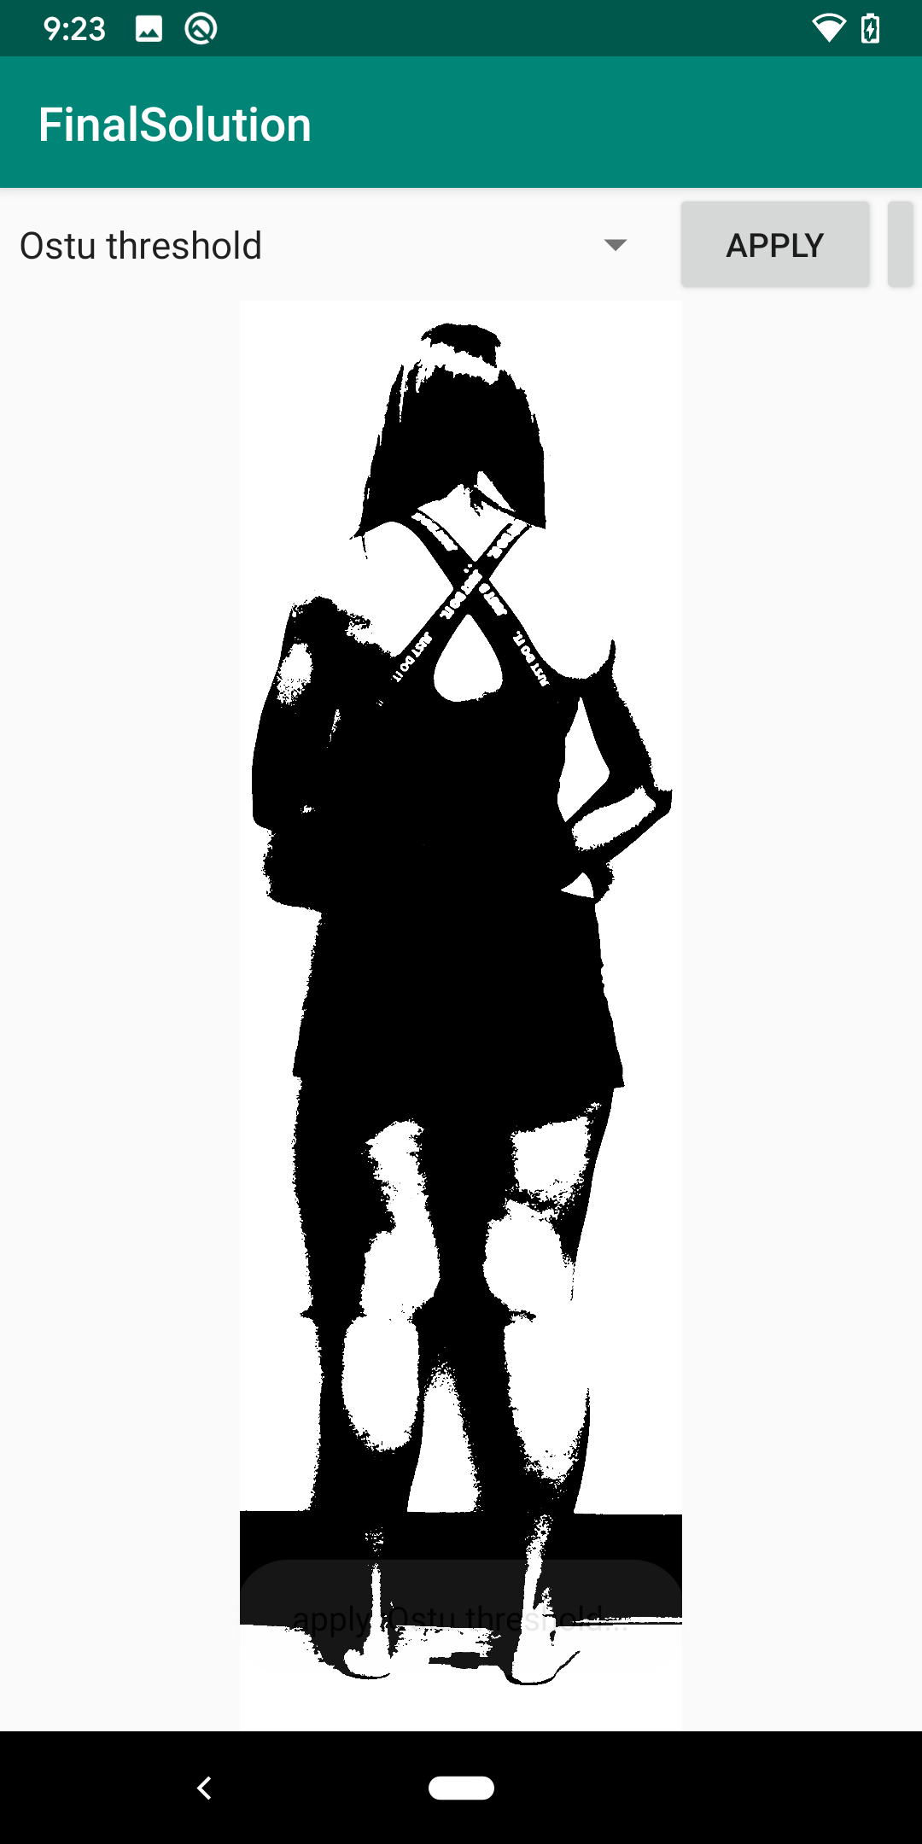
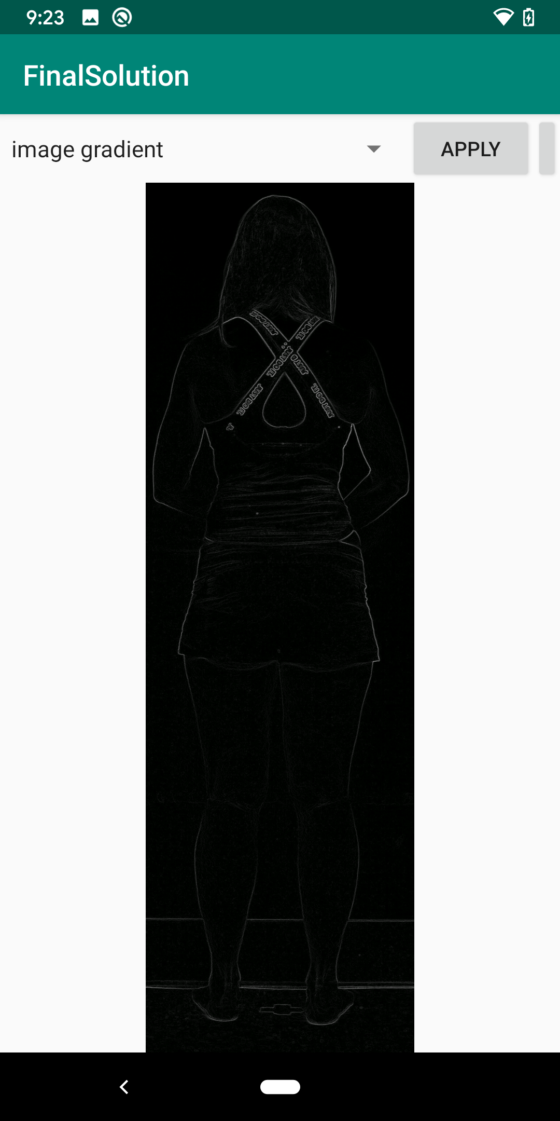
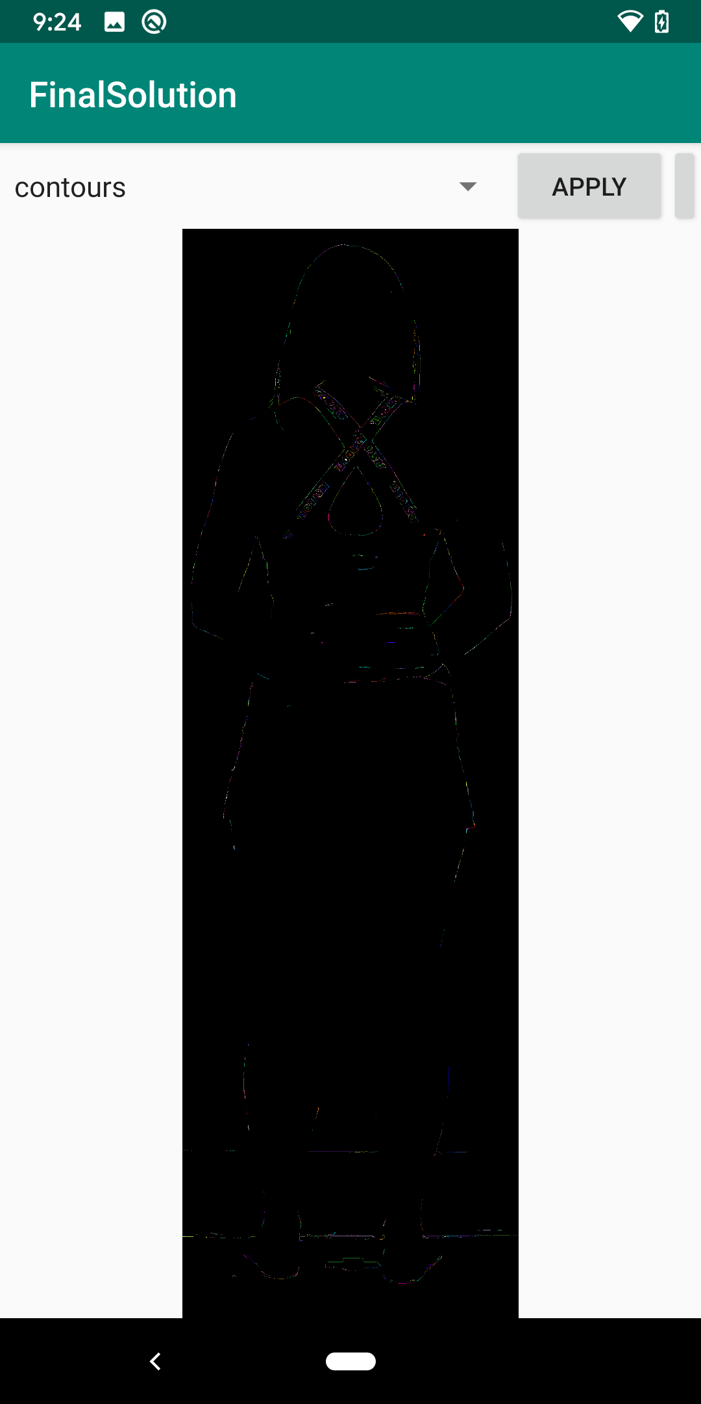
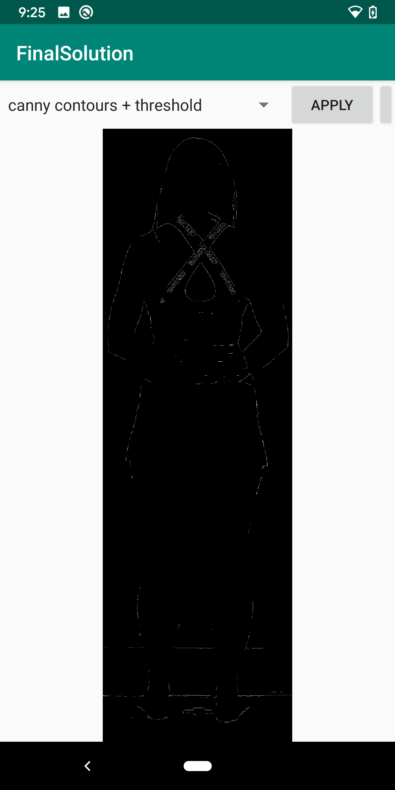
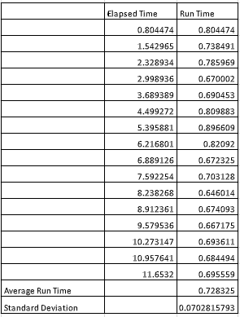
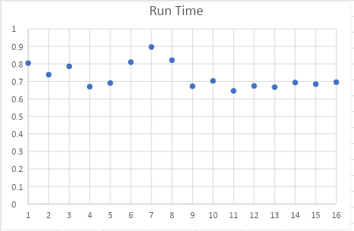
Automatic Body Information Measurement from Smartphone Images
Nguyen Hung Nguyen, Shengting Cao, Colin Adreon
Department of Electrical Engineering, University of Alabama, Tuscaloosa, AL
Introduction
A smartphone solution to quickly assess the body information is in need for clinic practitioners and football coaches in health tracking of patients and athletes.
Android Screenshots
Method
First, use image gradient, Ostu thresholding and k-mean clustering methods to process the image.
Second, find the extreme pixels according to the processed image.
Third, calculate the the height, waistline and hipline by subtraction.
Evaluation
Smartphone
output
MATLAB output
Fig.1 Those smartphone screenshots shows the outputs and the intermedia outputs.
Runtime
s
1 mm
(iii)
0.1mm
0.5m
Conclusion and Future Work
Our method did good job in MATLAB program but need work more on the smartphone solution.
Future work 1: Investigate how to shorten the runtime of the body information measurement and fix bugs in the smartphone.
Future work 2: How to apply our tool to the kinesiology college for body composition analysis.
Reference
[1] Otsu, N., "A Threshold Selection Method from Gray-Level Histograms." IEEE Transactions on Systems, Man, and Cybernetics. Vol. 9, No. 1, 1979, pp. 62–66.
[2] k-mean: Arthur, David, and Sergi Vassilvitskii. “K-means++: The Advantages of Careful Seeding.” SODA ‘07: Proceedings of the Eighteenth Annual ACM-SIAM Symposium on Discrete Algorithms. 2007, pp. 1027–1035.
[3] Nickerson BS, Fedewa MV, Cicone ZS, Esco MR. The relative accuracy of skinfolds compared to four-compartment estimates of body composition. Clin Nutr. 2019.
Acknowledgement
The authors will like to acknowledge our funding sources for the project: PFI-RP-1918534 and Nvidia GPU Grant Program
http://structurefunctionlab.com/

